Slide 1


DEJA VU: CONTINUAL MODEL GENERALIZATION FOR UNSEEN DOMAINS
CS771
Presented by (parameter hunters, team No:46):
1.Nagendra-241110044
2.Sudhakar-241110077
3.Dattatreya-241110048
4.yashwanth-241110082
5.Vinay Kumar Reddy-241110048

Slide 2
TABLE OF CONTENTS
INTRODUCTION
METHODOLOGY
RANDOM MIX
T2PL
PCA
EXPERIMENTS
CONCLUSION

Slide 3
INTRODUCTION
Challenge: Deep learning models face performance degradation in non-stationary environments due to domain shifts.
Limitations of Existing Approaches:
Domain Adaptation (DA): Ineffective during the Unfamiliar Period.(Online DA and Continual DA)
Domain Generalization (DG): Suffers from catastrophic forgetting.
Solution Objective: Address continual domain shifts and improve performance before and during adaptation.

Slide 4
DOMAIN ADAPTATION
DOMAIN GENERALIZATION
Here we use both source data and domain data
Example:
Autonomous Driving
You have an autonomous driving model trained on daytime driving data (Source Domain), but now you want to deploy the model in an area where the vehicle operates primarily at night (Target Domain)
Here only source domain data we use
Example:
Medical Image Diagnosis
You want a deep learning model that can diagnose diseases from X-ray images taken at various hospitals (each hospital is a different domain), but you don’t have access to data from a new hospital where the model will eventually be deployed.

Slide 5
METHODOLOGY
The main approach and contribution
They propose a framework called RATP that optimizes three objectives
To improve the model generalization on new target domain before and during its training namely the Target domain generalization(TDA) performance.
To provide good model performance on target domain right after its training namely the target domain adaptation
To maintain good performance on a trained domain after the model is trained with other domains namely the forget Alleviation (FA) performance

Slide 6
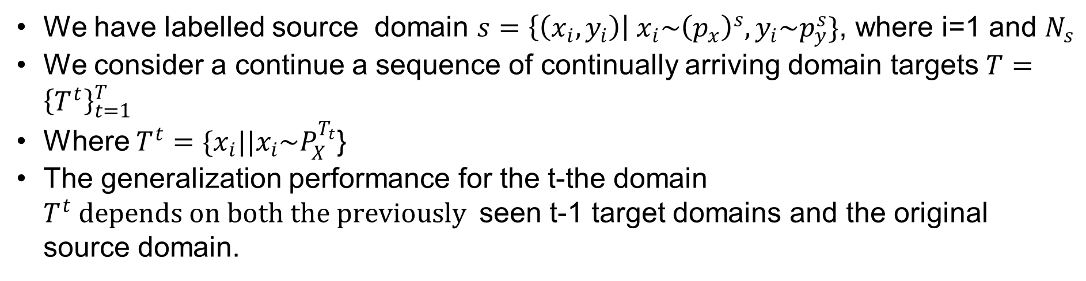
MEHTODOLOGY
We have labelled source domain $s=\left\{\left(x_{i},y_{i}\right)\right| x_{i}\sim {\left(p_{x}\right)}^{s},y_{i}\sim p_{y}^{s}\}$, where i=1 and $N_{s}$
We consider a continue a sequence of continually arriving domain targets $T={\left\{T^{t}\right\}}_{t=1}^{T}$
Where $T^{t}=\{x_{i}||x_{i}\sim P_{X}^{T_{t}}$}
The generalization performance for the t-the domain $T^{t} depends on both the previously$seen t-1 target domains and the original source domain.

Slide 7
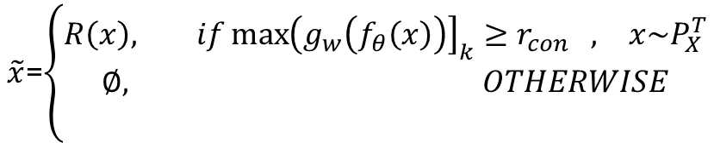
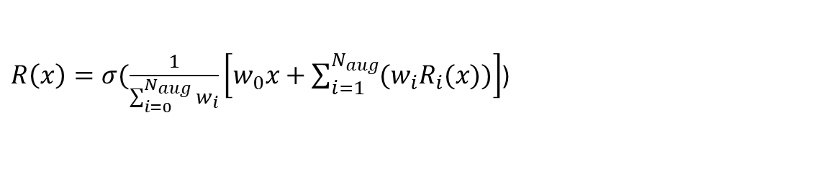
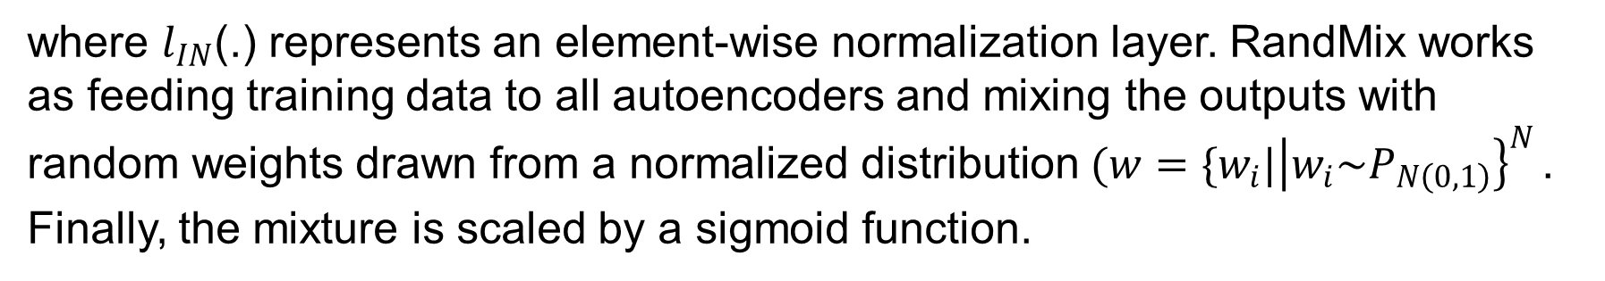
RANDOM MIX
At the beginning of CDSL, only a labeled source domain is available. Thus, we face a pure singe domain generalization problem where the model is trained on a single domain S and tested on the other unseen domains T (each domain in T is possible as the domain order is random)
We apply data augmentation and design a Random Mixup (RandMix) method to solve this problem
$$R\left(x\right)=d_{∁}(l_{∅_{1}}\left(n\right)×l_{IN}\left(e_{ε}\left(x\right)\right)+l_{∅_{2}}\left(n\right))$$
where $l_{IN}$(.) represents an element-wise normalization layer. RandMix works as feeding training data to all autoencoders and mixing the outputs with random weights drawn from a normalized distribution $(w=\{w_{i}|{\left|w_{i}\sim P_{N\left(0,1\right)}\right\}}_{}^{N}$. Finally, the mixture is scaled by a sigmoid function.
$\tilde{x}$=$\left\{\begin{aligned}R\left(x\right), if{\max\left(g_{w}\left(f_{θ}\left(x\right)\right)\right]}_{k}≥r_{con} , x\sim P_{X}^{T} \\ ∅, OTHERWISE \\ \end{aligned}\right.$
$R\left(x\right)=σ(\frac{1}{\sum_{i=0}^{N_{aug}}{w_{i}}}\left[w_{0}x+\sum_{i=1}^{N_{aug}}{(w_{i}R_{i}(x)})\right]$)

Slide 8
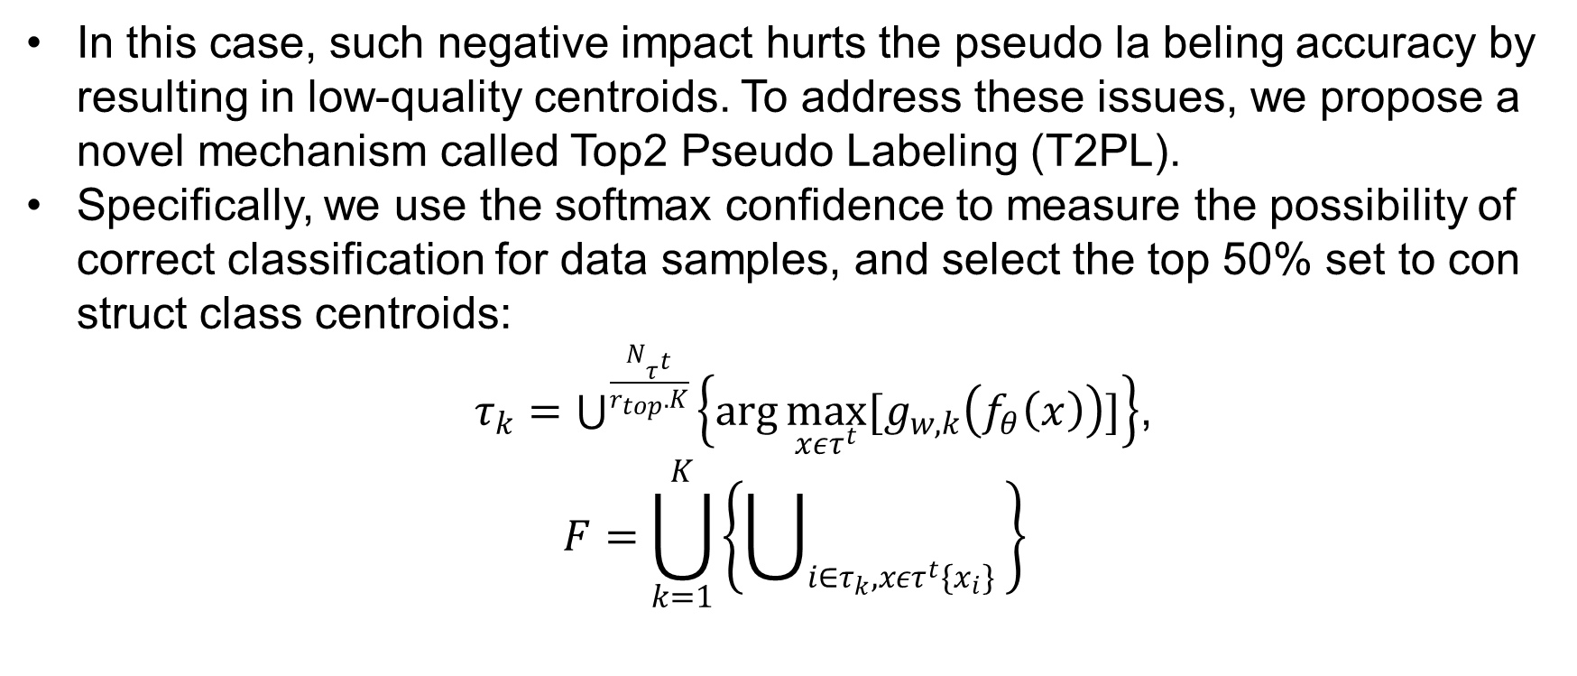
T2PL
During clustering, for a particular cluster, samples that exactly belong to the same class are often not used well and those misclassified pose a negative impact on centroid construction.
In this case, such negative impact hurts the pseudo la beling accuracy by resulting in low-quality centroids. To address these issues, we propose a novel mechanism called Top2 Pseudo Labeling (T2PL).
Specifically, we use the softmax confidence to measure the possibility of correct classification for data samples, and select the top 50% set to con struct class centroids:
$τ_{k}=\bigcup_{ }^{\frac{N_{τ^{t}}}{r_{top}.K}}{\left\{\arg{\max_{xετ^{t}}{[g_{w,k}\left(f_{θ}\left(x\right)\right)]}}\right\}}$,
$$F=\bigcup_{k=1}^{K}{\left\{\bigcup_{i∈τ_{k},xετ^{t}\{x_{i}\}}^{ }{ }\right\}}$$

Slide 9
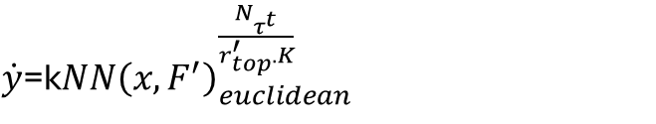
Subsequently, we can compute the cosine similarity between these centroids and representations of all current unlabeled data, and also select the top half set of samples that have much higher similarity to the centroids than the rest for each class
$$τ_{k}^{′}=\bigcup_{ }^{\frac{N_{τ^{t}}}{r_{top}.K}}{\left\{\arg{\max_{xετ^{t}}{[\frac{f_{θ}\left(x\right).p_{k}^{T}}{\left|\left|f_{θ}\left(x\right)\right|\right| ||{p||}_{k}^{T}}]}}\right\}}$$
$$F^{′}=\bigcup_{k=1}^{K}{\left\{\bigcup_{i∈{τ′}_{k},xετ^{t}\{{x_{i},k}_{,}\}}^{ }{ }\right\}}$$
$\dot{y}$=k$NN{\left(x,F^{′}\right)}_{euclidean}^{\frac{N_{τ^{t}}}{r_{top}^{′}.K}}$

Slide 10
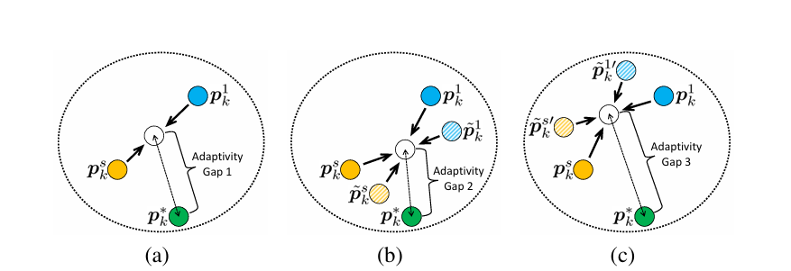
PROTOTYPE CONSTRASTIVE ALIGNMENT

Slide 11
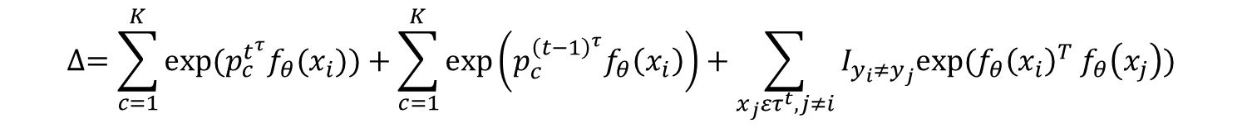
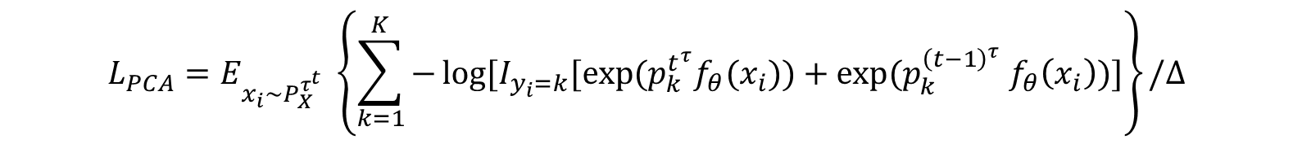
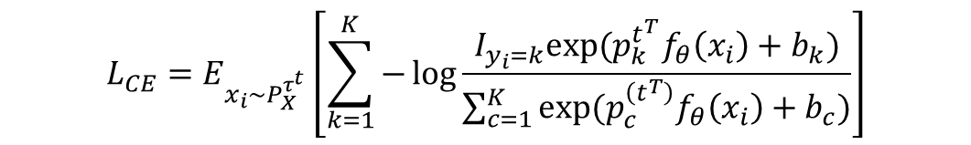
PCA
$$L_{CE}=E_{x_{i}\sim P_{X}^{τ^{t}}}\left[\sum_{k=1}^{K}{−\log{\frac{I_{y_{i}=k}exp⁡(p_{k}^{t^{T}}f_{θ}\left(x_{i}\right)+b_{k})}{\sum_{c=1}^{K}{exp⁡(p_{c}^{\left(t^{T}\right)}f_{θ}\left(x_{i}\right)+b_{c})}}}}\right]$$
$$L_{PCA}=E_{x_{i}\sim P_{X}^{τ^{t}}} \left\{\sum_{k=1}^{K}{−\log{[I_{y_{i}=k}[exp⁡(p_{k}^{t^{τ}}f_{θ}(x_{i}}}))+exp⁡(p_{k}^{{\left(t−1\right)}^{τ}} f_{θ}\left(x_{i}\right))]\right\}/∆$$
$$∆=\sum_{c=1}^{K}{exp⁡(p_{c}^{t^{τ}}f_{θ}(x_{i}))}+\sum_{c=1}^{K}{\exp\left(p_{c}^{{\left(t−1\right)}^{τ}}f_{θ}\left(x_{i}\right)\right)+\sum_{x_{j}ετ^{t},j≠i}^{ }{I_{y_{i}≠y_{j}}exp⁡(f_{θ}{\left(x_{i}\right)}^{T} f_{θ}\left(x_{j}\right))}}$$
$L=L_{CE}+L_{PCA}+L_{DIS}$ $L_{DIS}=D_{KL}\left[g_{w}^{t−1}{(f}_{θ}^{t−1}\left(x\right)\right)|{\left|g_{w}^{t}\left(f_{θ}\left(x\right)\right)\right]}_{x\sim P_{X}^{T^{τ}}}$

Slide 12
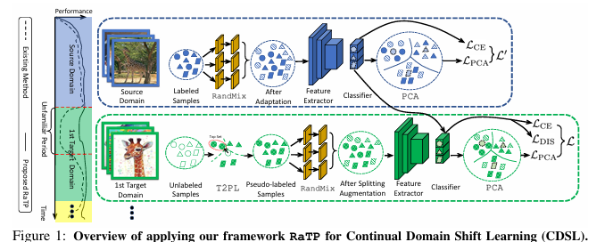

Slide 13
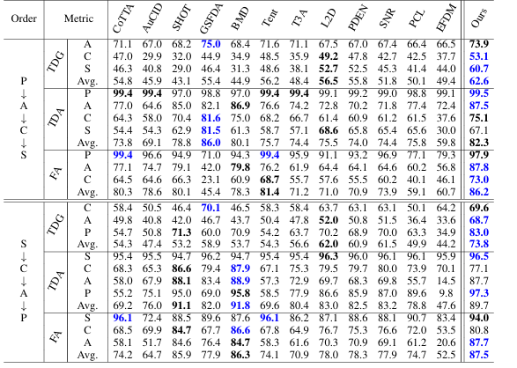
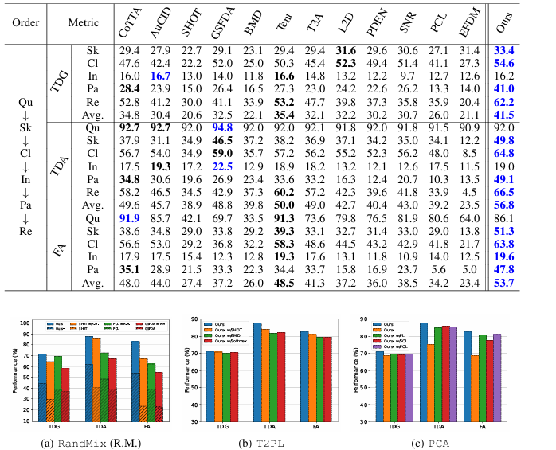
EXPERIMENTS
On PACS dataset
On domain net data set

Slide 14
CONCLUSION
Proposed RaTP framework to tackle Continual Domain Shift Learning (CDSL).
Achieved state-of-the-art generalization during the Unfamiliar Period.
Introduced innovative modules: RandMix, T2PL, and PCA.
Demonstrated robust performance across diverse benchmarks.
Successfully balanced generalization, adaptation, and Forgetting alleviation.

